Slide 1

Sellinger Applied Portfolio
Portfolio Review | Fall 2014

Slide 2

Contents
Overview
Economic Conditions
Sector Summaries
Portfolio Strategy & Composition
  Growth
  Value
  Dividend
  ETF
Risk Analysis
Performance Review
Student Biographies
Appendix
2

Slide 3
OVERVIEW
Fall 2014
3

Slide 4
Sellinger Applied Portfolio Overview
Background
The Sellinger Applied Portfolio, “SAP Fund,” is a student-managed investment portfolio. Each year
the University may provide the portfolio with up to $500,000 to invest. These funds are a
component of the University’s endowment.
Fall 2014
21 students managed the portfolio over the fall semester of 2014 and recommended a number of buys
and/or sells via the process outlined below:
Stocks Selected & Analyzed
Analysis & Recommendation Presented
Students Vote
on Team Recommendation
Teams Established
Teams Present
Class Votes

Slide 5
Sellinger Applied Portfolio Overview
Objective
Select stocks that are undervalued and will outperform their industry and the S&P 500
index over the course of the investment period.
Mandate
Asset allocation targets:
Not more than 10% invested in any one stock
Not more than 20% invested in any one sector
Not more than 25% invested in any one index
40% Value | 40% Growth | 20% Dividend
No “sin” stocks
Benchmark
S&P 500 Index

Slide 6
ECONOMIC CONDITIONS
Fall 2014
6

Slide 7
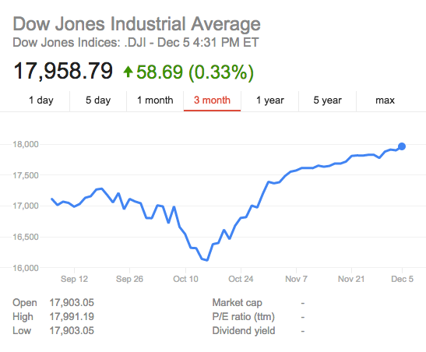
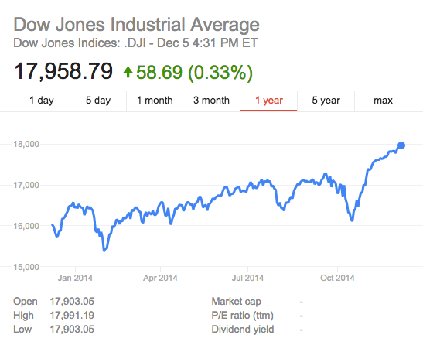
Market Overview
Fairly Volatile Semester for DJIA
  Fell ~ 5% Mid October
    “Mini Recession”
      Ebola, ISIS, Oil prices, Russia/Ukraine conflict
  Rose ~ 11% from low to exceed record highs

Slide 8
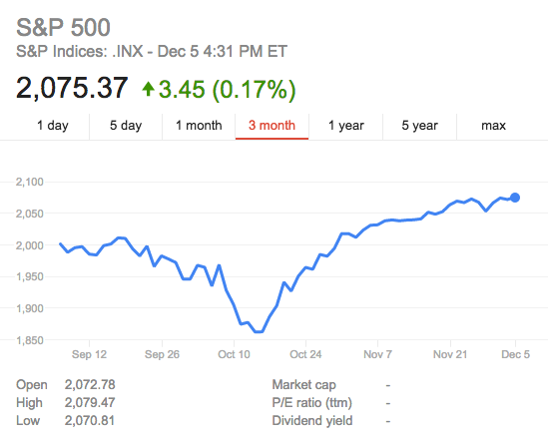
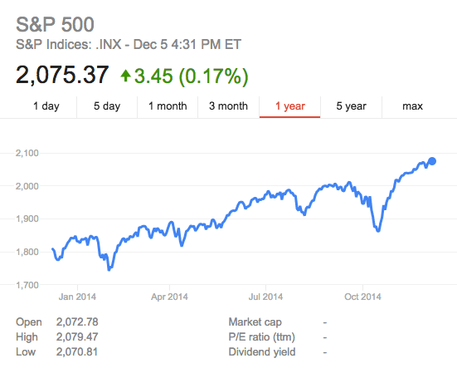
S&P 500 3-Month and 1-Year Returns

Slide 9

Federal Reserve Policy
Ongoing events contributing to FED policy
This October the Federal Reserve ended its quantitative easing program with GDP growing steadily and unemployment dropping throughout the year
FOMC officials indicated that interest rates are going to be low for longer than expected, with rate hikes predicted to occur after March of 2015.
  Weak International growth in both the Eurozone and Asian markets
  Appreciating U.S. dollar hurting U.S. exports
  Labor market under utilization
  Federal Reserve still in pursuit of full employment
    Expansionary policy still being pursued at year end with federal funds rate remaining constant

Slide 10
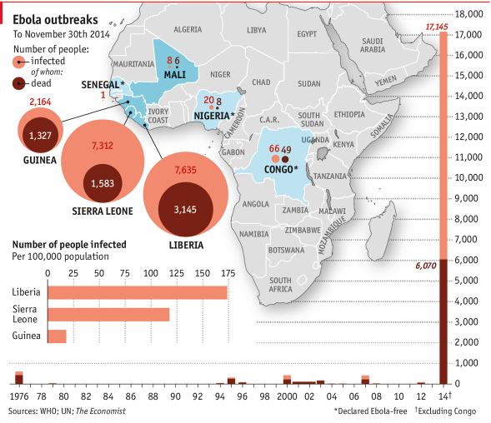
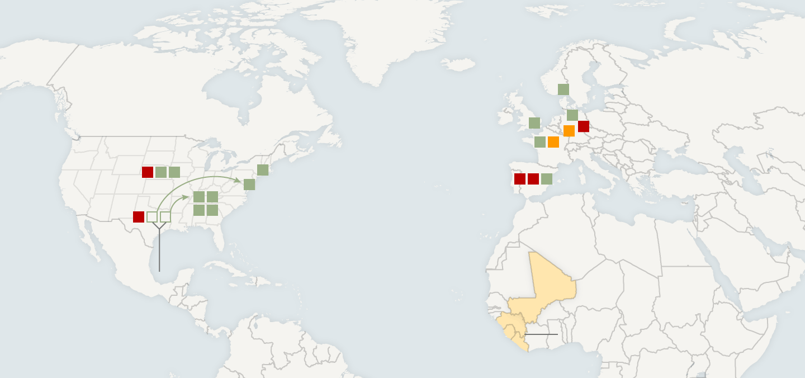
International News
Ebola
  Outbreak began in West Africa
  Has sickened 14,413 people since March and has killed 5,177 as of November 14th
  Affected airline stocks and pharmaceutical companies but no stocks within in our portfolio

Slide 11
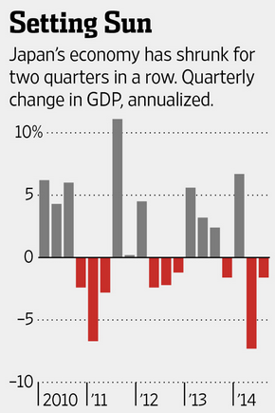
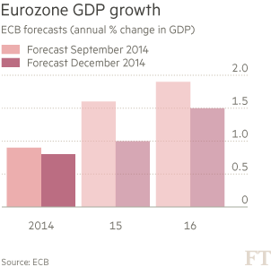
International Growth Concerns
Japan
  In November Japan entered a recession with a second consecutive quarter of decline in GDP growth
  GDP Contracted 1.6%, analysts predicted GDP to expand by 2.25%
  Recession likely attributed to Sales Tax hikes hurting consumer spending
  Japan surprisingly increased stimulus to 80 trillion yen per year, boosting the global stock markets to all time highs
Eurozone
  Eurozone GDP forecasts have been cut again in December with the overall Eurozone economy predicted to expand at .8% this year
  Draghi has reassured global investors that the ECB will reassess the need for QE at the beginning of 2015
  ECB’s decision to hold off on QE shook European markets, investors are optimistic for additional stimulus to be announced in January

Slide 12
Oil Price Concerns
International News
Winners of International Oil Price Crash
Oil prices around the world have fallen more than 38 percent since the year's high in June.
Among the winners are airlines which are saving in fuel costs and beneficial to two of our portfolio holdings
Bank of America predicts airline earnings will gain 73 percent in 2015
Losers of International Oil Price Crash
Cheaper oil challenges the economic developments of Canada's oil sands and may slow down the Keystone XL pipeline
Railroad stocks fell as investors bet that lower oil prices would curtail rail shipments

Slide 13
ISIS
International News
Started as an al Qaeda splinter group
  Aim to create an Islamic state across Sunni areas in Iraq and Syria
Currently controls hundreds of square miles
  Ignores international borders
    Rules by Sharia Law
Investor Concerns
  Has not affected the stock market drastically
  Markets have remained impervious to political turmoil this year
    Investors would only be concerned with ISIS if they started to destroy oil refineries

Slide 14
SECTOR SUMMARIES
Fall 2014
14

Slide 15
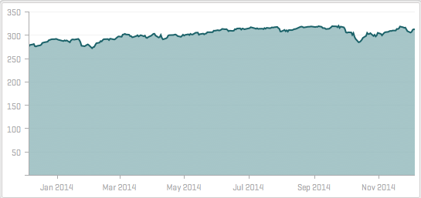
Basic Materials
The sector is comprised of firms involved with the discovery, development and processing of raw materials. Other subsectors include miners and refiners of metals, chemical producers and forestry product companies. BM is sensitive to supply and demand fluctuations because the price of raw materials, such as gold or other metals, is largely demand driven. According to S&P indices, the Basic Materials sector has returned 15.97%, which underperformed the larger S&P 500 by 2.7%.
To see above-average return, the economy must realize consecutive quarters of positive GDP (a strong economy can afford to invest in construction projects that in turn increase the demand for the products and services of firms within BM). Although the U.S. economy is currently roaring, European and Asian economies are in troubled states. Accordingly, BM’s current weight in the S&P 500 is about 3.2%. Our view of BM is that there are considerable macroeconomic factors outside the United States, which raise our skepticism toward further allocated investment in this sector. With such a tentative view of this sector, we have approached our allocation (3%) similar to the S&P 500(3.2%).
Stocks to Watch
Alcoa (AA)
Dow Chemical Co (DOW)
DuPont (DD)
Sherwin-Williams Co (SHW)*
YPF Sociedad Anonima (YPF
*In Portfolio
Basic Materials Sector SPDR ETF

Slide 16
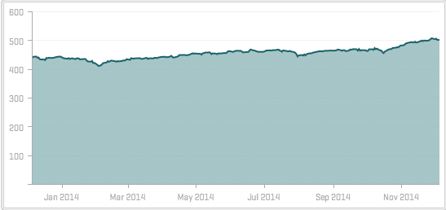
Consumer Staples
Consumer Staples includes companies that focus on manufacturing and distribution of food, beverages, tobacco, as well as producers of non-durable household goods and person products. By nature, the sector is less sensitive to economic cycles.
In the past year, Consumer Staples has returned 18.3%, which barely underperformed the S&P 500 by 37 basis points. The S&P 500 allocates 9.9% to Consumer Staples currently.
Our target allocation was 5.93%, which is nearly 4% less than that of the S&P 500’s 9.9%. As China and Germany struggle and Japan spirals downward, manufacturing, too, will slow. We viewed this sector bearishly.
Stocks to Watch
Procter and Gamble (PG)
The Coca-Cola Company (KO)
Philip Morris International (PM)
Consumer Staples Sector SPDR ETF

Slide 17
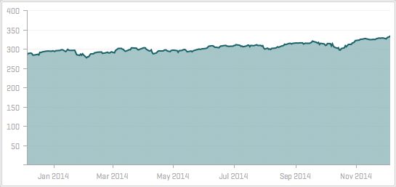
Financials
The Financials sector is comprised of firms that operate both domestically and internationally in a host of capital market processes including investment banking, asset based lending, fixed income securities, capital financing, equity trading and investments, credit services and insurance brokerages, etc.
The global economy depends on the financial institutions to function naturally. However, various ethical lapses in the sector led up to the worst recession experienced since the 1920s. In response, the U.S. government increased oversight of the major banks, which in return has caused revenues to deteriorate. The increased regulation, negative public sentiment, and the onslaught of cyber security breaches were red flags in our eyes as we determined our target allocation. Although the sector has outperformed the S&P 500 by 1.17%, we believe the sector carried substantially higher risk presently.
Our targeted allocation for this sector was 8.27% while the S&P 500 holds 16.2%.
Stocks to Watch
Bank of America (BAC)
Wells Fargo (WFC)
Goldman Sachs Group, Inc (GS)
JPMorgan Chase & Co. (JPM)
Financial Sector SPDR ETF

Slide 18
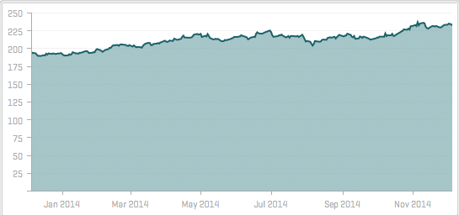
Utilities
The Utilities sector covers firms focused on the generation and distribution of electricity, gas, water, etc. Interest rate changes impact this sector immensely because utility companies normally have large amounts of debt.
With the Fed ending their QE program, Janet Yellen (Fed Chairwoman) has made it clear that interest rates will be raised from their historically low levels. In response to this, we feel the utilities sector will suffer as this process unfolds. In the past year, the sector has crushed the S&P 500 by roughly 7%. This in part is from extremely low interest rates. With Janet Yellen and the Fed in mind, we wanted to limit our exposure to this sector.
We allocated no capital to Utilities while the S&P 500 held 3%.
Stocks to Watch
Duke Energy Corp (DUK)
Dominion Resource, Inc. (D)
Utilities Sector SPDR ETF

Slide 19
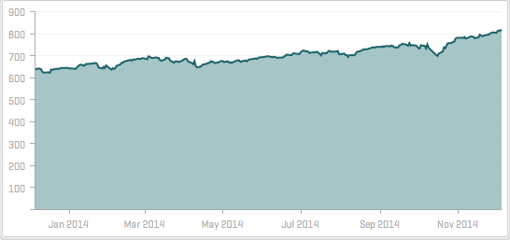
Healthcare
The Healthcare sector includes firms related to medical and healthcare goods or services (i.e., hospital management organizations (HMOs), biotechnology). This sector is less sensitive to economic cycles because the demand for healthcare goods and services is relatively constant.
Over the past year, the sector has returned nearly 14% more than the S&P 500. Three reasons for this: (1) the continuation of the bull market (2) the Affordable Care Act’s lag period is over (3) increase M&A activity
With this in mind, our target allocation (14%) for this sector was similar to the S&P 500 (14.3%).
Stocks to Watch
Pfizer Inc. (PFE)
Johnson & Johnson (JNJ)*
Merck & Co., Inc (MRK)
*In portfolio
Healthcare Sector SPDR ETF

Slide 20
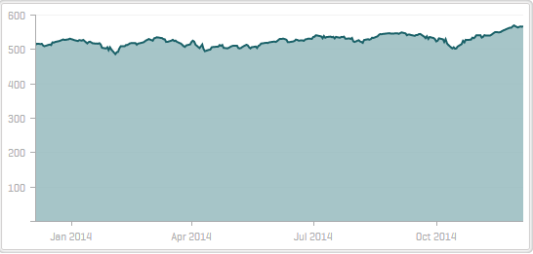
Consumer Discretionary
Consumer Discretionary consists of firms that offer non-essential goods and services including retailers, hotels, restaurants, leisure, media companies, consumer services companies, consumer durables, etc. Historically, consumer discretionary performs better in bullish markets. To track this sector, we used the SPDR ETF, which currently has a 52-week range of $61.03 to $71.95. The current weight of the Consumer Discretionary sector in the S&P 500 is about 11.90%. Year-to-date, the Consumer Discretionary sector has underperformed the S&P 500 by 5.2%. Over the last three months, the Consumer Discretionary sector has basically been in lockstep with the overall index, only underperforming by 10 basis points.
Consumer spending has been dismal overall for 2014. A sluggish economic recovery coupled with a natural post-crisis deleveraging amongst American households has hurt the sector in a significant way. While the holiday season offers a substantial bullish opportunity, weak consumption numbers early on have been a drag on the sector as expectations continue to decline for the underlying firms.
Stocks to Watch
Priceline (PCLN)
Southwest Airlines (LUV)
Starbucks (SBUX)
Consumer Discretionary Sector SPDR ETF

Slide 21
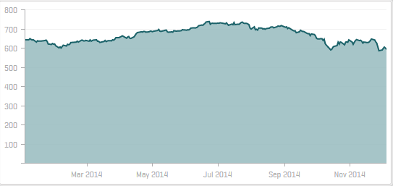
Energy
The Energy sector is comprised of firms representing the oil, gas, consumable fuels, and
equipment and service provider industries. Historically, the sector is mildly more volatile than the
market, being much more sensitive to fluctuations in oil and gas prices, as well as new
technological developments. YTD performance has been drastically adversely affected by recently
plummeting oil prices which caught many off guard, sending the energy ETF down over 9% on the
year, suffering a 17% decline in the past three months. ‘
While turmoil in the middle east usually provides a lift to crude prices, geopolitical conflict
over the summer in Syria and Iraq did not disrupt production, and Libya actually increased its
overall supply, as two factions are both selling oil to fund civil war efforts.
More recently, an OPEC decision to cut prices again and maintain production levels took
many investors off guard, sending futures even lower. As OPEC initiates a price war with US shale
gas producers, consumers benefit from cheaper fuel prices while energy firms suffer material hits
to their revenues.
Stocks to Watch
Schlumberger (SLB)
Halliburton (HAL)
Honeywell (HON)
Energy Sector SPDR ETF

Slide 22
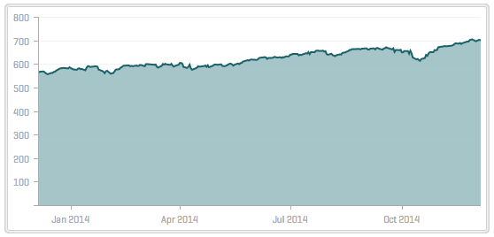
Information Technology
The Information Technology sector is comprised of companies who focus on two general areas: Technology Software & Services and Technology Hardware & Equipment. Firms earn profits through the manufacturing of electronics, creation of software, maintenance of computers or products and services relating to information technology.
Online service portals are under heavy pressure to transform user traffic into revenue through various different avenues. Semi-Conductor stocks tend to perform well at the front-end of an economic cycle. They have played a large role in this sector’s year to date success due to its 47% growth. Computer hardware has also shown excellent growth- 39.5% year to date. IT Services and Consulting has shown the least growth year to date- 4.47%. The sector as a whole has grown by 2.2% over the past 3 months and 21% year-to-date.
Stocks to Watch
Apple (AAPL)
Facebook (FB)
Information Technology Sector SPDR ETF

Slide 23
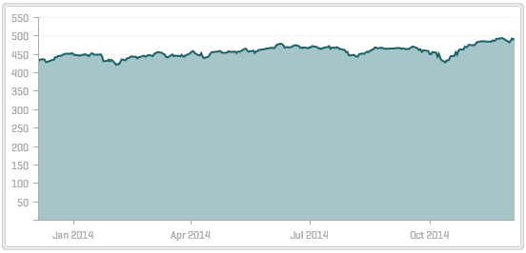
Industrials
The Industrials sector is comprised of a wide variety of firms including but not limited to firms involved in construction, aerospace, defense, machinery, tools, and several other industries. The sector is largely dependent on supply and demand for building construction as well as the demand for manufactured products. In the event of an economic contraction consumers save more and spend less, as a result the industrials sector drops because companies will cut back on expansion and produce fewer goods.
The Industrials sector has grown by 1.27% over the past 3 months but has declined by .48% year to date. The Heavy Electrical Equipment industry has played a major role in this slow growth due to its -11.2% decline year to date. Airline stocks within the sector have performed very well over the past year showing a 63.54% growth. Rails & Roads have also shown excellent growth.
Stocks to Watch
Northrop Grumman (NOC)
Southwest Airlines (LUV)
Caterpillar (CAT)
Lockheed Martin (LMT)
Industrials Sector SPDR ETF

Slide 24
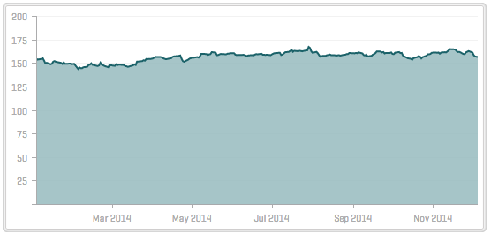
Telecommunications
The Telecommunication services sector contains companies that provide communications services primarily through fixed-line, cellular, wireless, high bandwidth and/or fiber optic cable network. Integrated Telecommunications services have grown by almost 10% over the past year. However, Wireless telecommunications services have declined by 2.5%.
Overall the sector has seen an increase of 5.26% in the past year. Large growth can be found in companies who provide fast connection rates and provide better security for their customers.
Stocks to Watch
U.S. Cellular (USM)
Telecommunications Sector SPDR ETF

Slide 25
PORTFOLIO STRATEGY & COMPOSITION
Fall 2014
25

Slide 26
Growth Strategy Overview
To find stocks expected to grow faster than their industry peers
Buy Criteria
- Conservative Mentality – Expect to perform better than Industry
- Revenue growth ≈> industry average and forecasted to Continue
- Strong Earnings ~ 5 years of CAGR
- ROE ≈ ≥ 15% and > Industry Average
- PEG ≈ ≤ 1.2 and < Industry Average
- Debt / Equity < 1.5 (or Acceptable Interest Coverage Ratio when D/E >1.0)
Sell Criteria
Re-evaluate positions when:
  - The price reaches 10% below target price
  - The price is 20% above purchase price.
Evaluate Sell under following:
  - Company loses its leadership position
  - Company business fundamentals
  deteriorate.
  - Slowing unit volume, revenue decline, etc.
  - Superior investment alternatives are
  identified.

Slide 27
Growth Strategy Overview
Stop Loss Criteria
- Establish at 80% of Purchase Price
- Evaluate as information and stock price changes
- If stock appreciates – move stop loss up accordingly (consider trailing / crawling stop)
- If company business fundamentals deteriorate – raise stop loss or sell per sell criteria
- Earnings miss, lower guidance, slowing revenue growth etc.
Position Changes
Priceline
Southwest Airlines
EOG Resources
Schlumberger
AmTrust Financial Services
Facebook
Methode Electronics

Slide 28
Growth Strategy Position Changes
As of December 4, 2014
Priceline | pcln
Buy Criteria
 | Conservative Mentality – Expect to perform better than Industry | Revenue growth ≈> industry average and forecasted to Continue | Strong Earnings ~ 5 years of CAGR | ROE ≈ ≥ 15% and > Industry Average | PEG ≈ ≤ 1.2 and < Industry Average | Debt / Equity < 1.5 (or Acceptable Interest Coverage Ratio when D/E >1.0)
PCLN | YES | 30.1% vs. 7.8% | 29.2% | 14.3% vs. 10.7% | .8 | 4. vs .5
Position Change
Purchase 14 shares ($16416.4)
PCLN was bought due to an expected increase in average salaries, which would result in an increase in discretionary spending.

Slide 29
Growth Strategy Position Changes
As of December 4, 2014
Southwest Airlines | luv
Buy Criteria
 | Conservative Mentality – Expect to perform better than Industry | Revenue growth ≈> industry average and forecasted to Continue | Strong Earnings ~ 5 years of CAGR | ROE ≈ ≥ 15% and > Industry Average | PEG ≈ ≤ 1.2 and < Industry Average | Debt / Equity < 1.5 (or Acceptable Interest Coverage Ratio when D/E >1.0)
LUV | Yes | 13.5% vs. 9.7% | 18.32% | 16% vs. 38% | 1.5 | 0.3 vs. 1.6
Position Change
Purchased 450 shares ($17,358.75)
Southwest Airlines stands to benefit from lower jet fuel costs. Due to the Ebola scare LUV appeared to be undervalued.

Slide 30
Growth Strategy Position Changes
As of December 4, 2014
EOG Resources | EOG
Buy Criteria
 | Conservative Mentality – Expect to perform better than Industry | Revenue growth ≈> industry average and forecasted to Continue | Strong Earnings ~ 5 years of CAGR | ROE ≈ ≥ 15% and > Industry Average | PEG ≈ ≤ 1.2 and < Industry Average | Debt / Equity < 1.5 (or Acceptable Interest Coverage Ratio when D/E >1.0)
EOG | Yes | 15.2% vs.15.1% | 9.9% | 15.5% vs. 5.9% | 0.78 | 0.3 vs. 0.5
Position Change
Purchase 220 shares ($20,382.12)
EOG has a knack for creative cost control, sizeable positions that should drive production, and significant know-how regarding drilling.

Slide 31
Growth Strategy Position Changes
As of December 4, 2014
Schlumberger| SLB
Buy Criteria
 | Conservative Mentality – Expect to perform better than Industry | Revenue growth ≈> industry average and forecasted to Continue | Strong Earnings ~ 5 years of CAGR | ROE ≈ ≥ 15% and > Industry Average | PEG ≈ ≤ 1.2 and < Industry Average | Debt / Equity < 1.5 (or Acceptable Interest Coverage Ratio when D/E >1.0)
SLB | Yes | 17.4% vs. 16% | 11% | 17.4 vs. 10.8% | .9 | 0.3 vs. 0.4
Position Change
Purchased 350 shares ($11,691.36)
Stop-lossed at 20%
As oil becomes more expensive to extract oil service firms will benefit. Also SLB’s aggressive R&D stands to expand market share and profits.

Slide 32
Growth Strategy Position Changes
As of December 4, 2014
facebook | FB
Buy Criteria
 | Conservative Mentality – Expect to perform better than Industry | Revenue growth ≈> industry average and forecasted to Continue | Strong Earnings ~ 5 years of CAGR | ROE ≈ ≥ 15% and > Industry Average | PEG ≈ ≤ 1.2 and < Industry Average | Debt / Equity < 1.5 (or Acceptable Interest Coverage Ratio when D/E >1.0)
FB | Yes | 58.6% vs. 28.6% | N/A | 15.55% vs. 12.5% | 1.05 | 0.0 vs. 0.1
Position Change
Purchase 165 shares ($12,672)
Facebook has a large customer base across multiple countries. They have
a strong portfolio of mergers and acquisitions recently and have been
experimenting with a new way of online advertising.

Slide 33
Growth Strategy Position Changes
As of December 4, 2014
Methode electronics | MEI
Buy Criteria
 | Conservative Mentality – Expect to perform better than Industry | Revenue growth ≈> industry average and forecasted to Continue | Strong Earnings ~ 5 years of CAGR | ROE ≈ ≥ 15% and > Industry Average | PEG ≈ ≤ 1.2 and < Industry Average | Debt / Equity < 1.5 (or Acceptable Interest Coverage Ratio when D/E >1.0)
MEI | Yes | 21.8% vs. 3.5% | 12.5% | 29.2% vs. 9.1% | 0.76 | 0.1 vs. 0.3
Position Change
Purchased 200 shares ($17,916.40)
Methode Electronics maintains a diverse amount of products across a
broad range of industries. Because of this, they have a strong, loyal
customer base.

Slide 34
Growth Strategy Position Changes
As of December 4, 2014
Amtrust financial | afsi
Buy Criteria
 | Conservative Mentality – Expect to perform better than Industry | Revenue growth ≈> industry average and forecasted to Continue | Strong Earnings ~ 5 years of CAGR | ROE ≈ ≥ 15% and > Industry Average | PEG ≈ ≤ 1.2 and < Industry Average | Debt / Equity < 1.5 (or Acceptable Interest Coverage Ratio when D/E >1.0)
AFSI | Yes | 39.1% vs. 5.2% | 36.2% | 24.1% vs. 10.2% | 0.59 | 0.5
Position Change
Purchased 350 shares at $89.582 ($14,280.00)
AmTrust Financial is globally diverse, providing operations in developed
and developing markets. The company offers specialty insurance programs
that allow for a diverse mix of products.

Slide 35
Value Strategy Overview
To find stocks priced less than their intrinsic value.
Buy Criteria
- Price/Sales < industry average
- Price/Book Value < industry average
- Dividends > Industry Average
- Positive Free Cash Flow
Sell Criteria
Re-evaluate positions when:
  - Merger or acquisition news
  - Significant earnings restatement
  - Change in executive management
  - Exceed initial price target
  - Price approaches sell stop
  - Superior investment alternatives are
  identified
Evaluate Sell under following:
  - Beginning to trend downwards
  - Significant industry news

Slide 36
Value Strategy Overview
Stop Loss Criteria
- 20% below purchase price if all buy criteria are met
- Adjust lower for additional risk (i.e., some buy criteria are not met)
- Increase stop loss to take profit as price increases
- Consider the use of crawling / trailing stops as stock begins to rise.
Position Changes
Wal-Mart
Caterpillar
Norfolk Southern Group
Stanley Black & Decker Inc.
Abbott Laboratories

Slide 37
Value Strategy Position Changes
As of December 4, 2014
Wal-Mart | WMT
Buy Criteria
 | Price/Sales < Industry average | Price/Book Value < industry average | Total cash dividends paid annually | Positive Free Cash Flow
WMT | 0.5 vs. 0.6 | 3.2 vs. 3.7 | 2.4% vs. 1.8% | Yes
Position Change
Purchased 135 shares ($10,241.64)
Wal-Mart Inc., prides itself in having the lowest prices for its consumers. It is competitive in the online shopping market as well as physical locations. An expanding model for new services makes it more unique than its competitors.
Notes:
The introduction of a clinic partnership in their stores would increase store traffic, get walmart partially into the expanding healthcare sector. Getting into banking for customers for low income customers with no overdraft fees would also increase traffic. Also, the holiday season should lead to positive 4th quarter earnings.

Slide 38
Value Strategy Position Changes
As of December 4, 2014
Caterpillar | cat
Buy Criteria
 | Price/Sales < Industry average | Price/Book Value < industry average | Total cash dividends paid annually | Positive Free Cash Flow
CAT | 1.2 vs. 0.8 | 3.2 vs. 2.5 | 2.6% vs. 2.4% | Yes
Position Change
Purchased 145 shares ($14,298.45)
Caterpillar has a loyal customer base and the demand for their
products is pretty inelastic. Its hold on the mining market keeps the demand inelastic
and is a major revenue contributor.

Slide 39
Value Strategy Position Changes
As of December 4, 2014
Norfolk | Nsc
Buy Criteria
 | Price/Sales < Industry average | Price/Book Value < industry average | Total cash dividends paid annually | Positive Free Cash Flow
NSC | 3.0 vs. 3.7 | 2.8 vs. 3.8 | 2.0% vs. 1.4% | Yes
Position Change
Purchased 170 shares ($18,516.23)
Norfolk has better profit margins than its industry peers and freight shipping
is becoming a cheaper transportation method for companies. This is good
news for the fourth quarter because of the increased goods traffic for the
holidays. Also, they have proven to be pretty resilient in bad market
conditions, which was the case at the time of the purchase.

Slide 40
Value Strategy Position Changes
As of December 4, 2014
Stanley Black & Decker | swk
Buy Criteria
 | Price/Sales < Industry average | Price/Book Value < industry average | Total cash dividends paid annually | Positive Free Cash Flow
SWK | 1.3 vs. 1.5 | 2.1 vs. 2.7 | 2.1% vs. 1.6% | Yes
Position Change
Purchased 150 shares ($13,990.50)
Stanley Black & Decker is very well diversified in terms of its product line. It
has a everything from tools to home appliances. Its tool line is considered to
be the best in the construction industry, which provides a steady revenue
stream. Its exceptional performance over the past few years and
acquisition specialty companies, we decided that this would be a good
investment.

Slide 41
Value Strategy Position Changes
As of December 4, 2014
Abbott Laboratories | Abt
Buy Criteria
 | Price/Sales < Industry average | Price/Book Value < industry average | Total cash dividends paid annually | Positive Free Cash Flow
ABT | 3.2 vs. 4.2 | 3.0 vs. 3.7 | 1.9% vs. 0.6% | Yes
Position Change
Purchased 230 shares ($10,145.07
Abbott spun off their pharmaceuticals sector in order to get back to their
core focus, medical devices and nutritional products. Due to the core focus
we believed this well established company would yield good returns.

Slide 42
Dividend Strategy Overview
To find stocks fairly priced and offering a dividend yield greater than the S&P 500.
Buy Criteria
- Dividend Yield ≥ SPDR S&P Dividend ETF
- Quick Ratio ≥ Industry Average
- Total cash dividends paid annually
- Total cash from investing activities
- Total cash from operating activities
- Is there a constant dividend?
- Is there historical and potential dividend growth?
Sell Criteria
Evaluate Sell under following:
- Superior investment alternatives are identified
- Dividends are cut
- Free cash flow diminishes
- Stock price loses (≈20%)

Slide 43
Dividend Strategy Overview
Stop Loss Criteria
- 20% below purchase price is all buy criteria are met
- Consider crawling / trailing stops to protect profits.
Position Changes
Chevron

Slide 44
Dividend Strategy Position Changes
As of December 4, 2014
Chevron | cvX
Buy Criteria
 | Dividend Yield ≥ SPDR S&P Dividend ETF | Quick Ratio ≥ Industry Average | Total cash dividends paid annually | Total cash from investing activities | Total cash from operating activities | Is there a constant dividend? | Is there historical and potential dividend growth?
CVX | 3.43% vs. 2.17% | 0.99 vs. 0.32 | Yes | Yes | Yes | Yes | Yes – 3.55%
Position Change
Purchase 145 Shares ($17,125.12)
Stop-loss executed at 20%
Chevron offers dividend income with growth expectations above
the industry average. They have historically increased dividends with most
recently increasing by $.070 in February 2014

Slide 45
ETF Strategy Overview
Other than maintaining existing positions invested, this strategy was only utilized once during the semester
Buy Criteria
- Dividend Yield ≥ SPDR S&P Dividend ETF
- Quick Ratio ≥ Industry Average
- Total cash dividends paid annually
- Total cash from investing activities
- Total cash from operating activities
- Is there a constant dividend?
- Is there historical and potential dividend growth?
Sell Criteria
Evaluate Sell under following:
- Superior investment alternatives are identified
- Dividends are cut
- Free cash flow diminishes
- Stock price loses (≈20%)

Slide 46
ETF Strategy Position Changes
As of December 4, 2014
Guggenheim Solar ETF | TAN
Buy Criteria
Ticker | Dividend Yield ≥ SPDR S&P Dividend ETF | Quick Ratio ≥ Industry Average | Total cash dividends paid annually | Total cash from investing activities | Total cash from operating activities | Is there a constant dividend? | Is there historical and potential dividend growth?
TAN | 3.5% vs. 2.18% | 0.9 vs. 0.08 | Yes | Yes | Yes | Yes | Yes
 | Price/Sales < Industry average | Price/Book Value < industry average | Total cash dividends paid annually | Positive Free Cash Flow
BAX | 4.43% < 2.58% | 4.16% > 4.68% | 1.57% < 2.78% | $665 Million
Position Change
Purchased 545 shares ($20,382.13)
We expect that the solar industry will continue to outperform the energy sector in general. Despite the decline in oil prices, we expect that solar profit margins will continue to hold steady and that solar incentive programs will be renewed in 2015. TAN gives the portfolio exposure to all companies in the solar industry which allows for industry focused diversification.

Slide 47
Position Changes | Sells
As of December 4, 2014
Technology Select Sector SPDR Fund | XLK
Rationale
Sold upon purchase of 400 shares of Methode Electronics (MEI) at an acquisition value of $15,691.60.
Kept Information Technology sector exposure around target weight of 19.50%.
Mangers reasoned that MEI was expected to outperform the technology sector ETF.
Position Change
Sell complete position of 361.056 shares at a market value of 14,489.53.
XLK was sold on the premise that Methode Electronics was to outperform the SPDR Technology Sector ETF.

Slide 48
Position Changes | Sells
As of December 4, 2014
Industrial Select Sector SPDR ETF | XLI
Rationale
Sold to return portfolio exposure of Industrial sector to target weight of 15.00%.
The current portfolio exposure to the industrials sector is now overweight at 17.72%.
Cash collected from transaction was used to fund future equity purchases.
Position Change
Sell partial position of 280.0 shares at a market value of 16,010.40.
The portfolio managers reasoned that an extremely overweight position in the industrials sector would not be in the best interest of the fund. Although the managers expected the Industrial sector to outperform, exposure of this magnitude was too great to maintain.

Slide 49
Position Changes | Sells
As of December 4, 2014
Kohls Coporation | KSS
Rationale
Sold upon purchase of 450 shares of Southwest Airlines at an acquisition value of $17,358.75.
Mangers reasoned that LUV returns were to exceed potential returns on KSS.
Proceeds from the sale of KSS were used to purchase LUV.
KSS achieved the portfolio expected return and no additional value was expected in the short term.
Position Change
Sell complete position of 301.88 shares at a market value of 17,425.16.
The portfolio managers reasoned that Kohl's Corporation had produced enough returns and that Southwest Airlines would produce superior returns. Kohl's competitiveness in the clothing retail market was also questionable at the time of sale.

Slide 50
Position Changes | Sells
As of December 4, 2014
Qualcomm Inc. | qcom
Rationale
Sold to decrease Information Technology sector exposure to the target of 19.5%.
Took profit of approximately 10%.
Fund managers reasoned that cash could be used more wisely elsewhere in the future.
Position Change
Sell complete position of 301.66 shares at a market value of 20,965.42
This position was liquidated mainly to decrease the portfolio exposure to the info tech sector down to its target weight. This sale allowed for several purchases including the Guggenheim Solar ETF (TAN) on 10/28/2014.

Slide 51
Position Changes | Sells
As of December 4, 2014
Reliance Steel and Aluminum | RS
Rationale
Sold to partially fund the purchase of 241.00 shares of Halliburton Corporation (HAL) at an acquisition value of 14,792.10
Remaining proceeds were used to reduce portfolio AUM value to its specified 500,000.00.
Sale used to dial back overweight exposure to the Industrial sector.
Position Change
Sell complete position of 301.66 shares at a market value of 20,965.42
This position was liquidated mainly to decrease the portfolio value down to 500,000.00 and to dial back the exposure to the industrials sector. Proceeds were taken by Loyola University Maryland.

Slide 52
Position Changes | Sells
As of December 4, 2014
Michael Kors Holdings Ltd | Kors
Rationale
Sold complete position in order to fund purchase of 1,172.00 shares of Priceline Group Inc. (PCLN) at an acquisition value of 16,416.80.
Fund managers determined that upside potential for Priceline Group would exceed any returns achieved by holding KORS.
KORS met/exceeded the expected returns on the portfolio. Therefore, the fund managers decided to seek new securities with larger potential upside.
Position Change
Sell complete position of 200.00 shares at a market value of 15,136.80
This position was liquidated due to many different factors including raising the necessary funds to purchase PCLN. Additionally, the price to book and price to sales ratios no longer met the portfolio requirements.

Slide 53
Stop Loss Orders | Sell
As of December 4, 2014
Stop Loss Criteria
- 20% below purchase price if all buy criteria are met
- Adjust lower for additional risk (i.e., some buy criteria are not met)
- Increase stop loss to take profit as price increases
Please note that stop loss orders were executed during extremely volatile trading days. Most executed orders are highly attributed to the major market correction experienced in mid-September to mid-October of 2014.

Slide 54
PORTFOLIO RISK ANALYSIS
Fall 2014
54

Slide 55
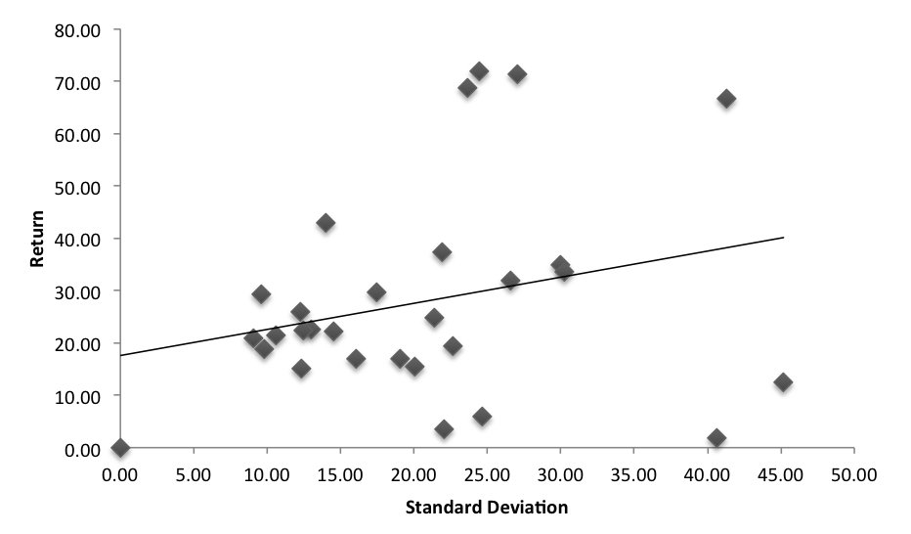
Portfolio Risk Analysis
As of November 30, 2014
STANDARD DEVIATION VS. RETURN (3YR)

Slide 56
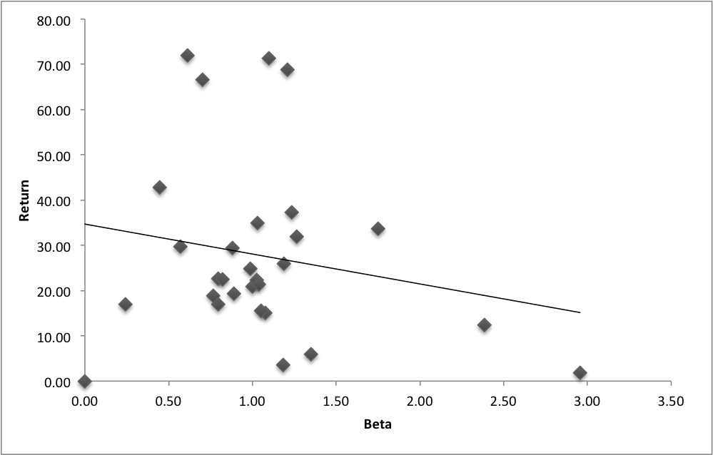
Portfolio Risk Analysis
As of November 30, 2014
BETA VS. RETURN (3 YR) | PORTFOLIO BETA (3YR): 1.03

Slide 57
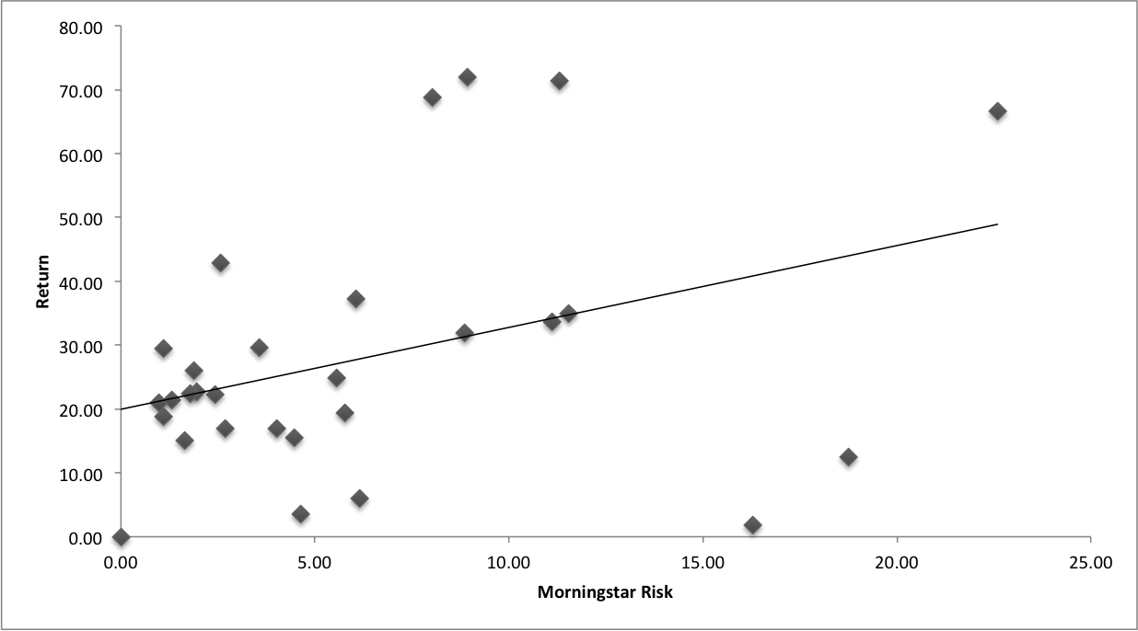
Portfolio Risk Analysis
As of November 30, 2014
MORNINGSTAR RISK VS. RETURN (3 YR)

Slide 58
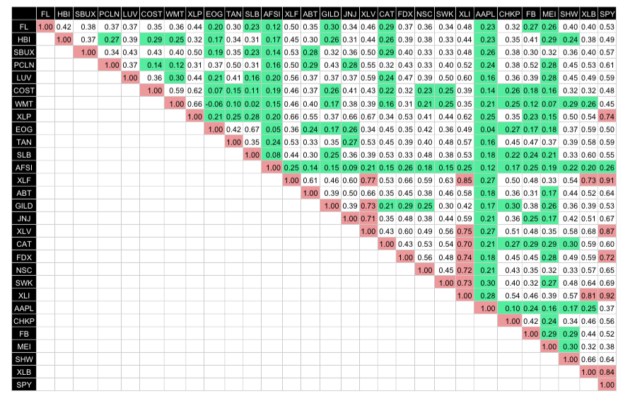
Portfolio Risk Analysis
As of December 4, 2014
CORRELATION MATRIX
Portfolio remains highly diversified with just three securities and the SPDR SP 500 ETF showing a correlation coefficient greater than 0.70.

Slide 59
PERFORMANCE
Fall 2014
59

Slide 60

Portfolio Holdings

Slide 61

Contents
Portfolio Analysis
Portfolio Risk/Return
Portfolio Performance
Top 10 Holdings (% Assets)
Top 5 Winners
Top 5 Losers

Slide 62
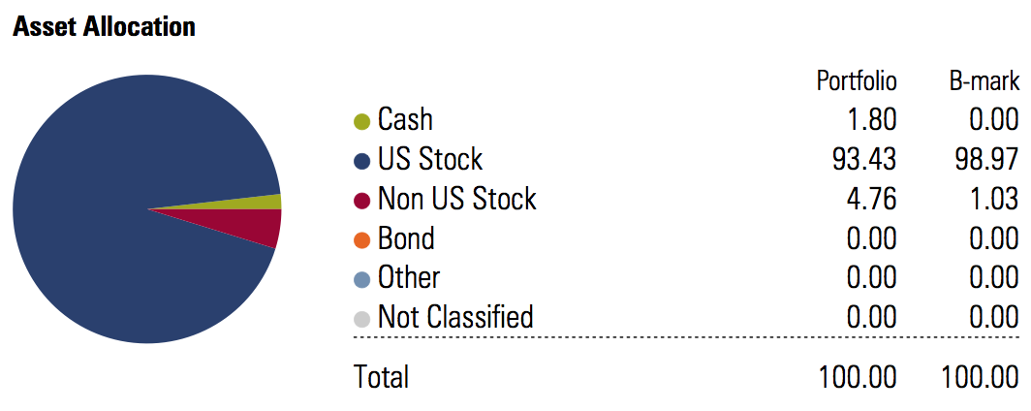
Portfolio Analysis

Slide 63
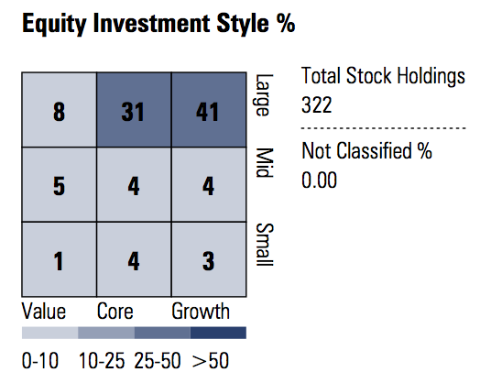
Portfolio Analysis

Slide 64
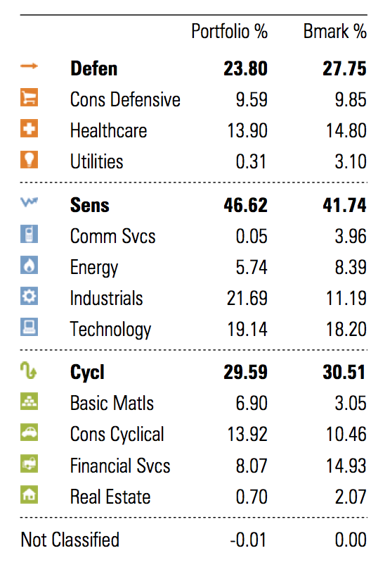
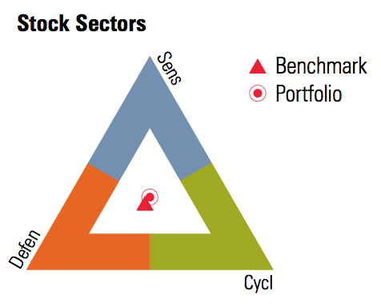
Portfolio Analysis
Fall 2014 Outlook:
Opportunities in Healthcare and Technology
  Baby boomers in need of healthcare, new medicines, and physical therapy
Slow growth in Financials
Volatility in Energy
  High supply, low demand driving oil prices down

Slide 65
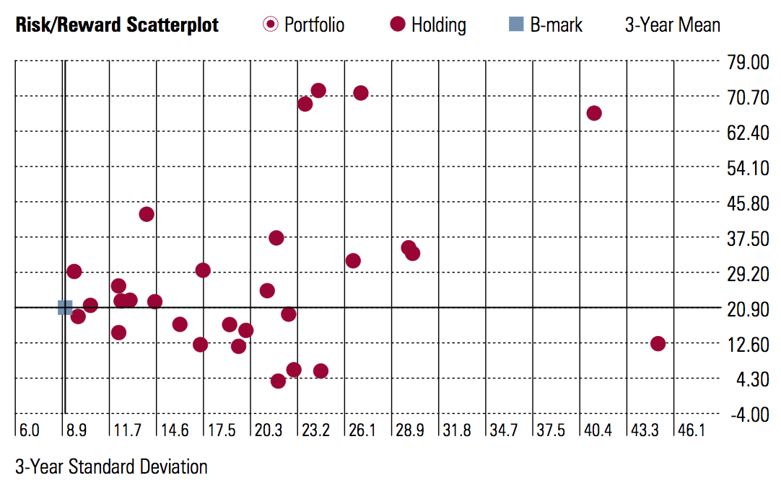
Portfolio Risk/Return
.

Slide 66
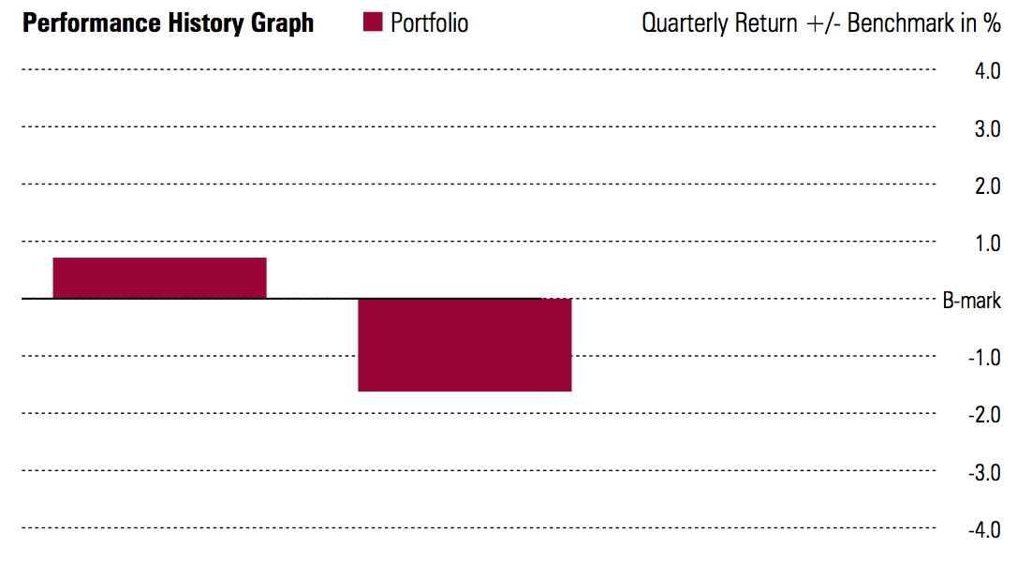
Portfolio Performance
Return of 4.46%
vs.
S&P 500 return of 3.81%
Portfolio Value $521,420.85 (as of 11/30/14)

Slide 67
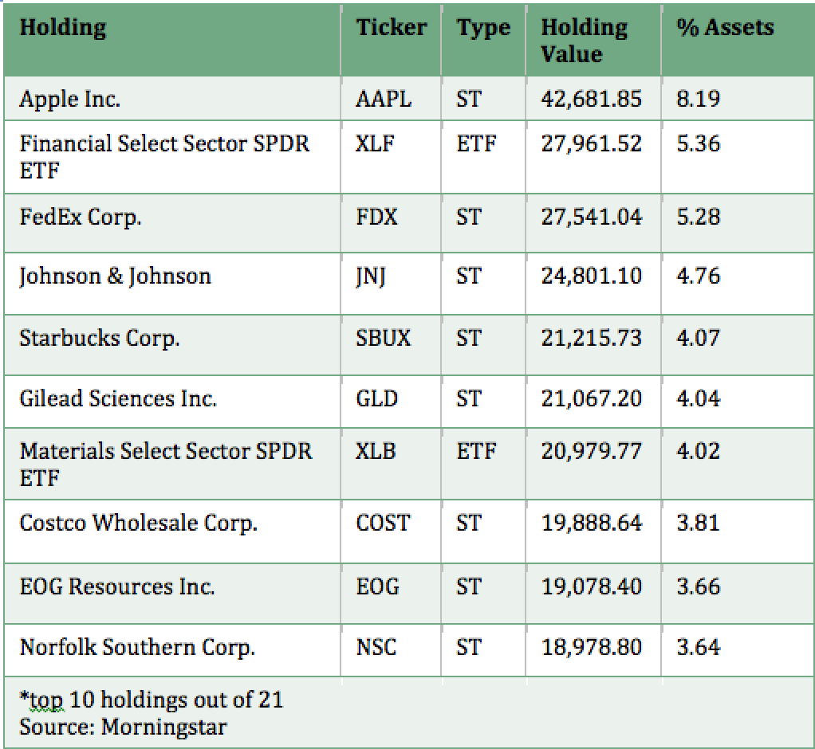

Slide 68
Top 5 Winners
AmTrust Financial Services (+26.50%)
Fedex Corp. (+19.71%)
Costco (+17.78%)
Sherwin Williams (+13.29%)
Wal-Mart (+11.97%)

Slide 69
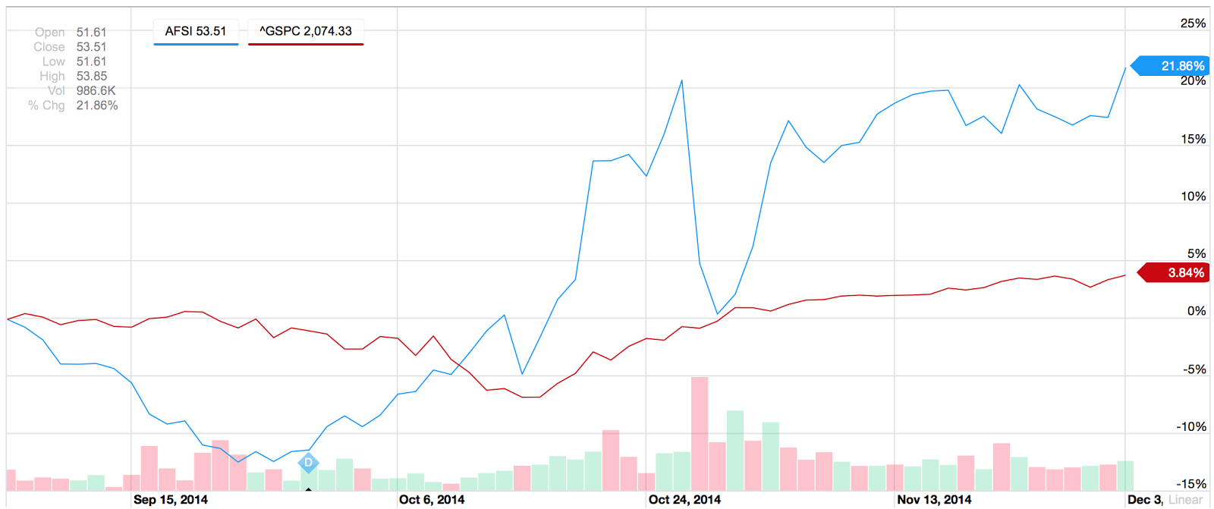
AmTrust Financial Services (AFSI)
Sector: Financials
Return: +26.50%
Increased common cash dividend by 25%
2Q earnings beat estimates
  reported $1.70 EPS
  revenue of $1B
  revenue up 37.7% YoY
Notes:
http://www.wkrb13.com/markets/419912/traders-buy-high-volume-of-amtrust-financial-services-put-options-afsi/

Slide 70
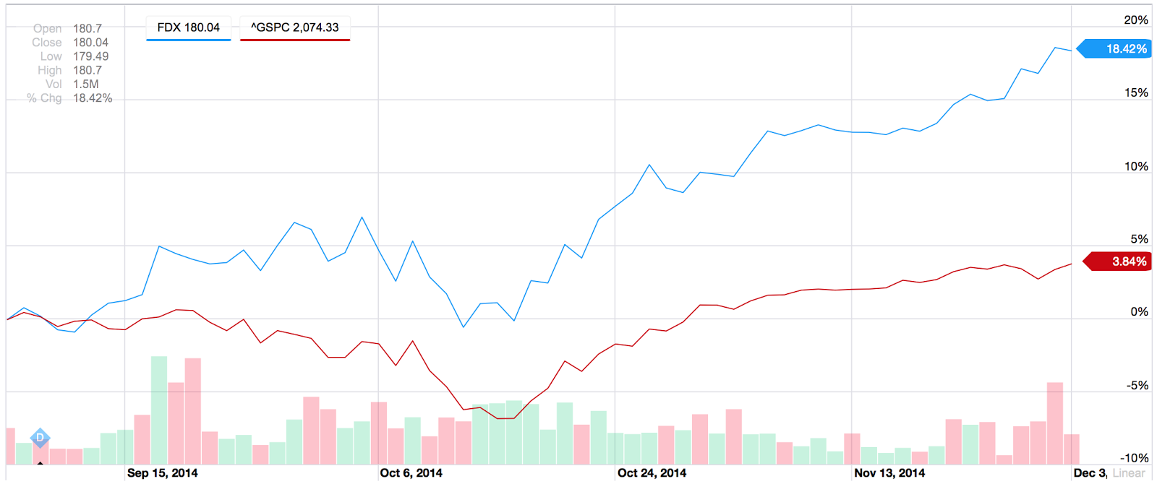
FedEx Corp. (FDX)
Sector: Industrials
Return: +19.71%
3Q earnings of $2.10/share
  Increase of 37% from same quarter last year
Significant growth in online shopping, especially with free shipping incentives
Notes:
http://seekingalpha.com/article/2704445-fedex-delivers-more-than-just-packages

Slide 71
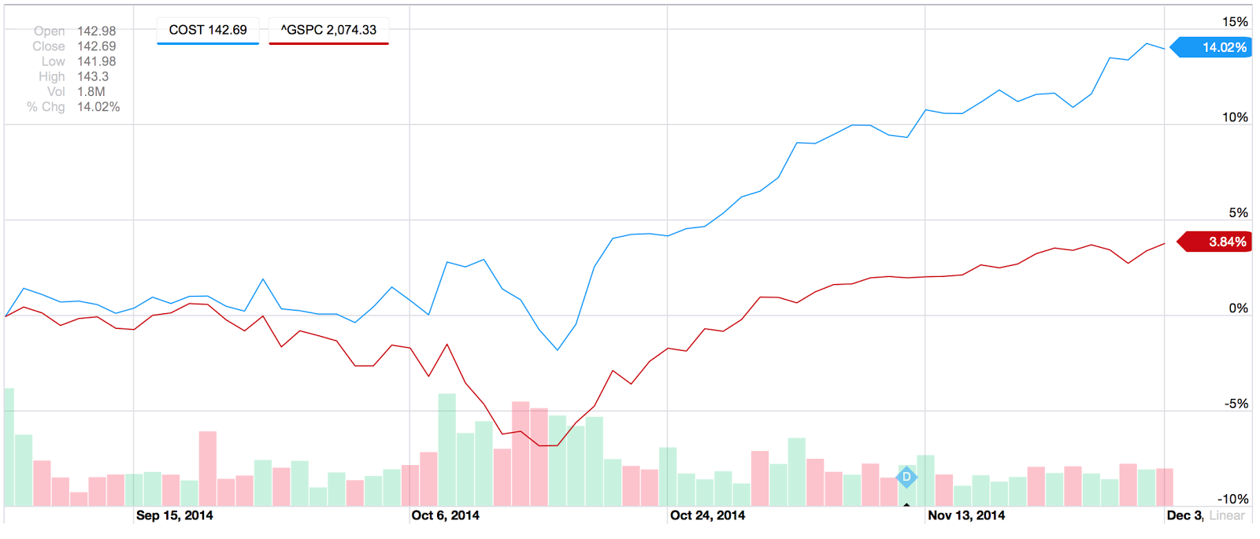
Costco (COST)
Sector: Consumer Staples
Return: +17.78%
+13% return since mid-October
Same-store-sale increase of 7.4% in October and 6.2% in November
2Q revenue increase by 9%
2Q net income gains of 13%
long-term growth attributable to international business
  October, COST announced planned entry of Chinese retail market
Steady growth despite soft U.S. Economy
Notes:
http://finance.yahoo.com/news/deutsche-bank-costco-expected-report-174717529.html
http://www.fool.com/investing/general/2014/11/19/how-costco-wholesale-leaped-13-in-a-single-month.aspx

Slide 72
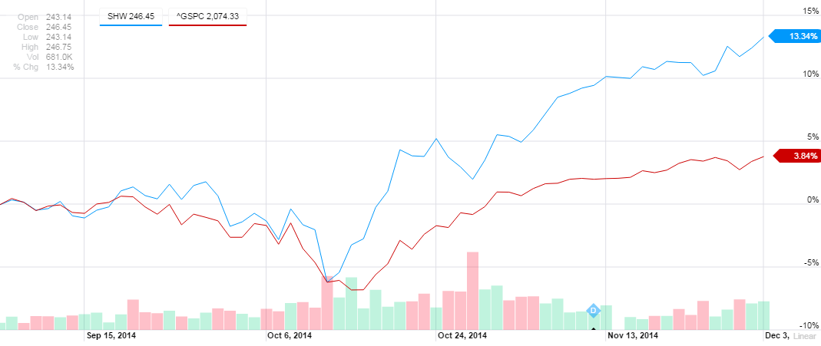
Sherwin Williams (SHW)
Sector: Materials
Return: +13.29%
Record $3.35/share Q3 earnings
10.6% year-over-year rise in net sales
Steady growth independent of house sales
  Dependence on professional clientele
Notes:
Sherwin-Williams recorded net sales of around $3,150.6 million in the quarter, a 10.6% year-over-year rise
Read more: http://www.nasdaq.com/article/sherwin-williams-shw-hits-new-52-week-high-at-23835-analyst-blog-cm413350#ixzz3KtTDZGem

Slide 73
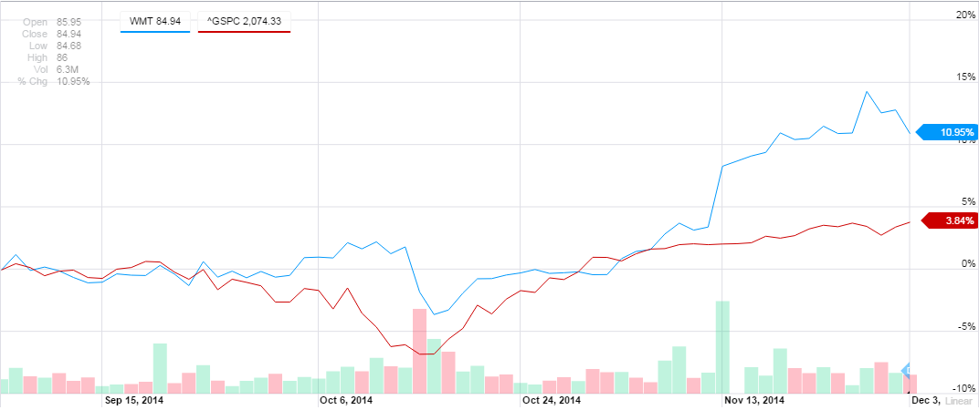
Wal-Mart (WMT)
Sector: Consumer Staples
Return: +11.97%
Topped earnings estimates in Q3
Overall U.S. same-store sales rose 0.5% in Q3
  Ended 6 quarter streak of flat/declining same store sales
Increased dividend 41 years in a row
Notes:
Overall U.S. same-store sales rose 0.5 percent, ending a six-quarter streak of flat or declining same-store sales

Slide 74
Top 5 Losers
Haliburton (-20.00%)
Chevron (-20.00%)
Google (-11.46%)
Schlumberger (-10.95%)
Gilead Sciences (-7.75%)

Slide 75
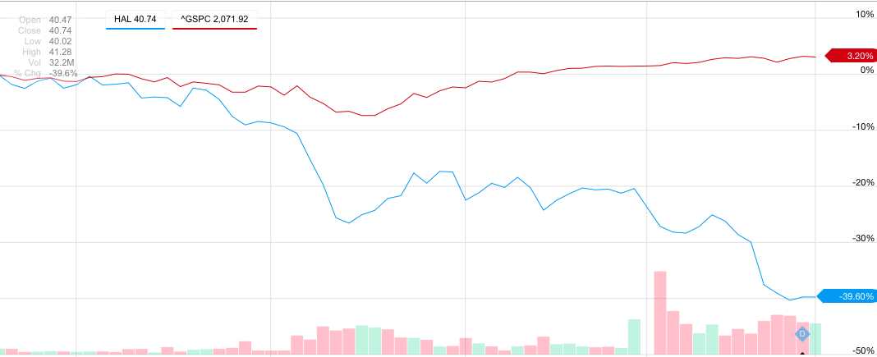
Halliburton (HAL)
Sector: Energy
Returns: -20%
Low oil prices hit the stock hard
Low prices slowed fracturing in North America, their biggest market
Beat Earnings in Q3

Slide 76
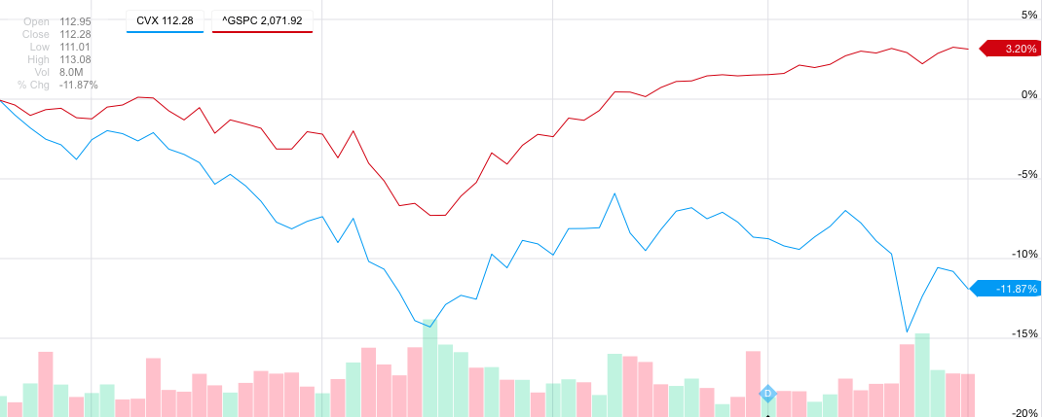
Chevron (CVX)
Sector: Energy
Returns: -20%
Low oil prices hit the stock hard
Beat Q3 Earnings Estimates
The company’s stake in politically turmoil left investors scared

Slide 77
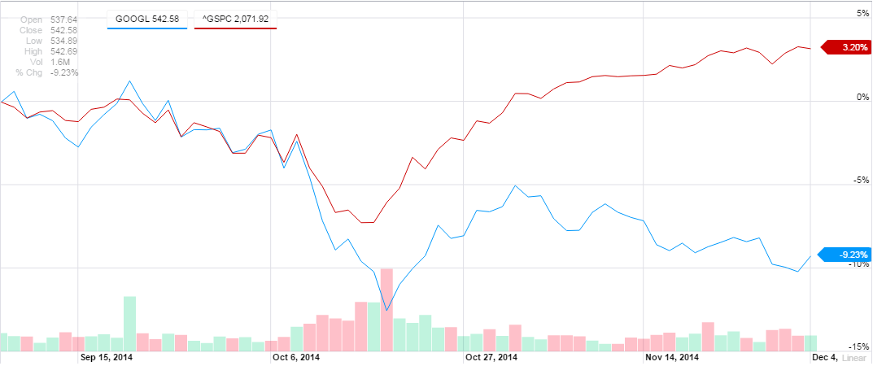
Google (GOOGL)
Sector: Information Technology
Return: -11.46%
Missed Analysts estimates for 3Q earnings
Losing market share in mobile search and desktop search to Bing and Yahoo, effecting revenues greatly
CPC (Cost Per Click) growth on advertisements has stalled, down 11% year over year

Slide 78
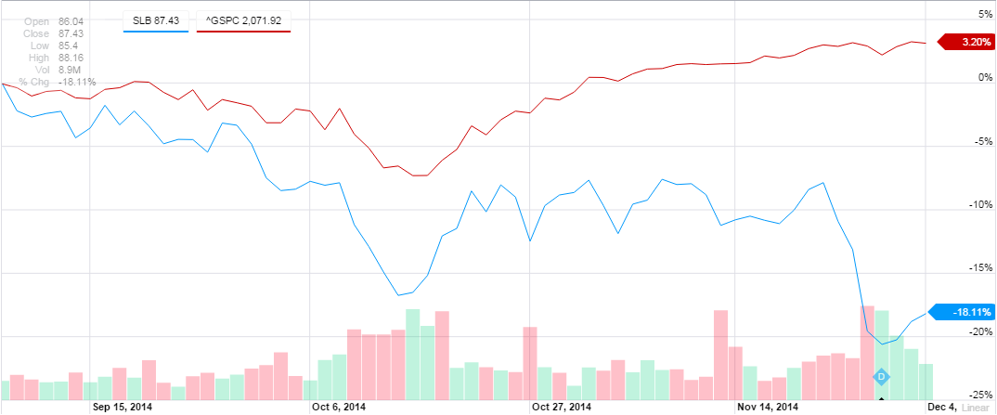
Schlumberger (SLB)
Sector: Energy
Return: -10.95%
OPEC’s decision to not cut oil production sent oil prices to its lowest levels since 2010
  Low oil prices sent the stock plummeting upon the announcement

Slide 79
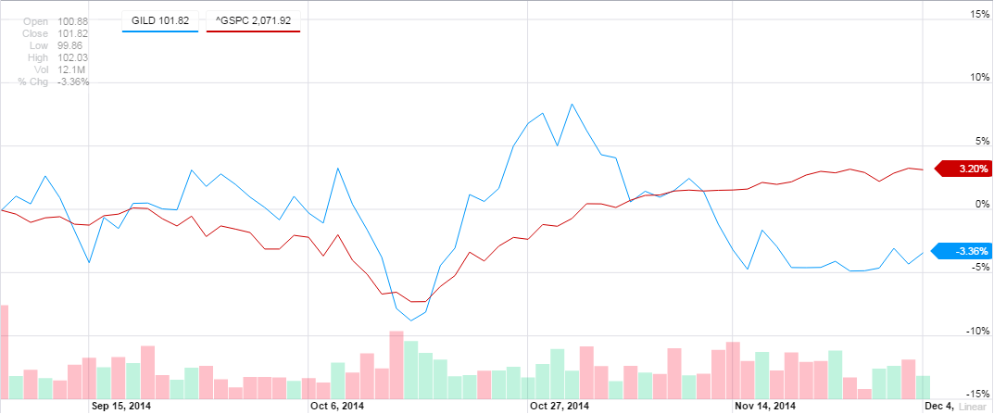
Gilead Sciences Inc. (GILD)
Sector: Health Care
Return: -7.75%
Missed Analysts estimates for 3Q earnings
Sales of Sovaldi, the hepatitis C drug, fell short of expectations
Recently received approval for Harvoni hepatitis drug
New prescriptions for hepatitis c drugs are slowing, according to Gilead, leading investors to question the firm’s prospects

Slide 80
STUDENT BIOGRAPHIES
Fall 2014
80

Slide 81


Biographies
Bridget Cahill is an undergraduate student pursuing
a Bachelors of Business Administration with a
concentration in Finance and a minor in Information
Systems. In addition to her undergraduate studies, she
has also interned for Synergy Investments, a
commercial real estate investment firm in Boston, MA.
Bridget is also a member of the Loyola chapter of the
Financial Management Association. Outside of the
classroom, Bridget volunteers at Arlington heights
Middle school tutoring sixth and seventh graders.
Bridget Cahill
B.B.A. ‘15
Tommy Rakowicz
Tommy Rakowicz is an undergraduate student
pursuing a Bachelors of Business Administration with a
concentration in Finance from Loyola University
Maryland. In addition to his undergraduate studies, he
is also a member of the Loyola chapter of the Financial
Management Association. Outside of the classroom he
is a volunteer for the York Road Initiative.
B.B.A. ‘15

Slide 82


Biographies
Dylan Kyriakakis is an undergraduate student
pursuing a Bachelors of Business Administration
with a concentration in Finance from Loyola
University Maryland. In addition to his
undergraduate studies, he has interned at both
Northmarq Capital and Cape Investment
Management. After graduation Dylan will
work at PricewaterhouseCoopers in their
Financial Instruments, Structured Products, and
Real Estate group in New York City.
Dylan Kyriakakis
B.B.A. ‘15
Connor Nelson
Connor Nelson is an undergraduate student
pursuing a Bachelors of Business Administration
with a concentration in Finance. In addition to his
undergraduate studies, he has had internships
in the pharmaceutical industry with Warner
Chilcott, and Sanofi-Aventis. He is actively
pursuing entry level Positions in the
pharmaceutical industry upon graduation.
Connor also shares an interest in wealth
management where he recently accepted an
intern position at Capitol Securities
Management Inc..
B.B.A. ‘15

Slide 83


Biographies
Joseph Van Calcar
Joseph Van Calcar is an undergraduate student seeking a Bachelor’s Degree in Business Administration with a concentration in Finance and minor in Information Systems. In addition to his undergraduate studies, he has spent the past three summers working as a summer intern for UBS Financial Services in their Wealth Management department. Joseph plans to seek a career in financial services in New York City.
B.B.A. ‘15
John Caruso
John Caruso is an undergraduate student pursuing a Bachelor of Business Administration with a concentration in Finance. To complement his concentration, John took an internship with Wells Fargo Securities in New York within the Public Finance branch of the investment bank. After graduation in May 2015, John will rejoin Wells Fargo Securities as a full time analyst within the Higher Education & Nonprofit group of Public Finance in New York.
B.B.A. ‘15

Slide 84


Biographies
Peter Zupan is pursuing a Bachelor’s degree in
Business Administration with a concentration in
Finance from Loyola University Maryland, where he is
a member of Beta Gamma Sigma and Alpha Sigma
Nu. Originally from Litchfield, Ohio, Pete is also a member of the women’s basketball practice squad
Pete Zupan
B.B.A. ‘14
Cole Swain is a prospective graduate pursuing
a Bachelors of Business Administration with a
concentration in Finance and Information systems. Cole
is originally from Medfield, MA. Upon graduation Cole
Intends to work in the field of finance, pursuing a career
in securities analysis or asset management.
Cole Swain
B.B.A. ‘15

Slide 85


Biographies
Reinaldo Blanco is an undergraduate student pursuing
a Bachelors in Business Administrationfrom Loyola
University Maryland with a concentration in Finance. He
is a member of the Sellinger Scholars program, Beta
Gamma Sigma, and is Vice President of the FMA. From
Union, New Jersey, he will be a Controller Analyst with
Goldman Sachs upon graduation.
Reinaldo Blanco
B.B.A. ‘15
Bryan Sullivan
Bryan Sullivan is a Senior at Loyola university
Maryland working towards his Bachelor of Business
Administration with a concentration in Finance and a
minor in Mathematics. He is a member of the Sellinger
Scholars program and Beta Gamma Sigma Honor
Society. Originally from Toms River, New Jersey,Bryan
hopes to work as an analyst in Baltimore.
B.B.A. ‘15

Slide 86


Biographies
Erica Lattanzio is an undergraduate student pursuing
a Bachelor of Business Administration in Finance from
Loyola University Maryland.
In addition to her current undergraduate studies, she is
the President of the Financial Management
Association, President of Club Ultimate Frisbee,
Secretary of Beta Gamma Sigma, a Resident Assistant
in Lange Court and a member of Alpha Sigma Nu
Erica Lattanzio
B.B.A. ‘15
.
Sabrina Friend
Sabrina Friend is an undergraduate student pursuing a Bachelor of Business Administration in Finance with an Economics minor from Loyola University Maryland. In addition to her current undergraduate studies, she is a member of Relay for Life and Action for Autism.
B.B.A. ‘15

Slide 87


Biographies
Amanda Adsit is an undergraduate student pursuing a Bachelor of Business Administration with a double concentration in Finance and Marketing from the Joseph A. Sellinger School of Business and Management at Loyola University Maryland. She is the Vice-President of Finance for Pi Sigma and a current intern at OneMain Financial.
Amanda Adsit
B.B.A. ‘15
Barrett Adams
Barrett Adams is an undergraduate student pursuing a Bachelor of Business Administration with a concentration in Finance from the Joseph A. Sellinger School of Business and Management at Loyola University Maryland. He recently worked as an energy intern with Noble Americas in Stamford, CT, and is a member of the Financial Management Association.
B.B.A. ‘15

Slide 88


Biographies
Kathleen Callan is an undergraduate student pursuing a Bachelor of Business Administration with a concentration in Finance and a minor in Information Systems from the Joseph A. Sellinger School of Business and Management at Loyola University Maryland. She is the President of Club Tennis and has previously interned at Merrill Lynch Wealth Management.
Kathleen Callan
B.B.A. ‘15
Perre Peraj is an undergraduate student pursuing a Bachelor of Business Administration with a concentration in Finance from the Joseph A. Sellinger School of Business and Management at Loyola University Maryland. He is President of Hounds on Wall Street and is currently interning at WMS Partners and Rosenblatt Securities.
Perre Peraj
B.B.A. ‘15

Slide 89


Biographies
Filip Zigic is a undergraduate student pursuing
a Bachelor of Business Administration with a
concentration in Finance from Loyola University
Maryland. In addition to his studies, he is a member of
Division I crew team at Loyola and a Sellinger Scholar.
Filip was a Credit Analyst intern at Stanley Black &
Decker and a Summer Analyst at Morgan Stanley.After
graduation, will be joining Morgan Stanley as an
Operations Analyst.
Filip Zigic
B.B.A. ‘15
Matthew J. Maloney is an undergraduate student
pursuing a BBA in Finance with a minor in Economics
from Loyola University Maryland. This past summer he
interned at Wilmington Trust as a Wealth Advisory
Intern Matthew is currently a FMA member and a
member of Beta Gamma Sigma. He has volunteered
for Habitat for Humanities. He plans on graduating in
May of 2015.
Matthew J. Maloney
B.B.A. ‘15

Slide 90


Biographies
Bryan Carney is an undergraduate student pursuing a Bachelor of Business Administration with a concentration in Finance and a minor in Information Systems from Loyola University Maryland. In addition to his studies, he is a member of the division I crew team at Loyola. Bryan currently works part-time for LaSalle Investment Management where he applies his in depth knowledge of real estate investment and financial analysis.
Bryan Carney
B.B.A. ‘15
William McNamara is a undergraduate student pursuing a Bachelor of Business Administration with a concentration in Finance from Loyola University Maryland and expects to graduate as a 2nd Lieutenant in the United States Army . William interned at OneWire over the summer of 2014 as a financial intern.
William McNamara
B.B.A. ‘15
William McNamara

Slide 91

Biographies
Jack MacDonald is an undergraduate student at Loyola University Maryland and is expected to graduate in May 2015 with a Bachelor’s degree in Business Administration with a concentration in Finance. He is a member of the FMA program at Loyola. Jack is from Short Hills, New Jersey and he will be pursuing a career in Management Consulting after graduation.
Jack MacDonald
B.B.A. ‘15

Slide 92

Professor Biography
Dr. Frank P. D’Souza earned a Ph. D. from
Oklahoma State University, an MBA from St. Cloud
State University, Minnesota and a Bachelor of
Commerce from the University of Bombay. He has been
published in several academic journals and holds
professional memberships with the Finance
Management Association, American Finance
Association, Eastern Finance Association,
Southwestern Finance Association and Beta Gamma
Sigma.
Dr. Frank P. D’Souza
Loyola University Maryland
Representative Publications
D'Souza, F., Ellis, N., & Fairchild, L., (2010), "Illuminating the Need for Regulation in Dark Markets: Proposed
Regulation of the OTC Derivatives Market", University of Pennsylvania Journal of Business Law, 12, 473-516
Carter, D., D'Souza, F., Simkins, B., & Simpson, W.G., (2010), "The Gender and Ethnic Diversity of US
Boards and Board Committees and Firm Financial Performance", Corporate Governance: An International
Review, 18(5), 396-414
Simpson, W. G., Carter, D., & D'Souza, F., (2010), "What Do We Know About Women on Boards", Journal of
Applied Finance, 20(2), 27-39
D'Souza, F., Fletcher, H., & Ionici, O., (2011), "Equity Market Timing and Subsequent Delisting Likelihood",
International Journal of Business and Finance Research, 5(2) 85-94
"Chapter 18: Cost of Capital: An Introduction", Ionici, O. & Small, K. & D'Souza, F., in "Capital Budgeting
Valuation: Financial Analysis for Today's Investment Projects". Edited by H. Kent Baker and P. English (2011).

Slide 93
APPENDIX
Fall 2014
93

Slide 94

Thank you.

